Slide 1
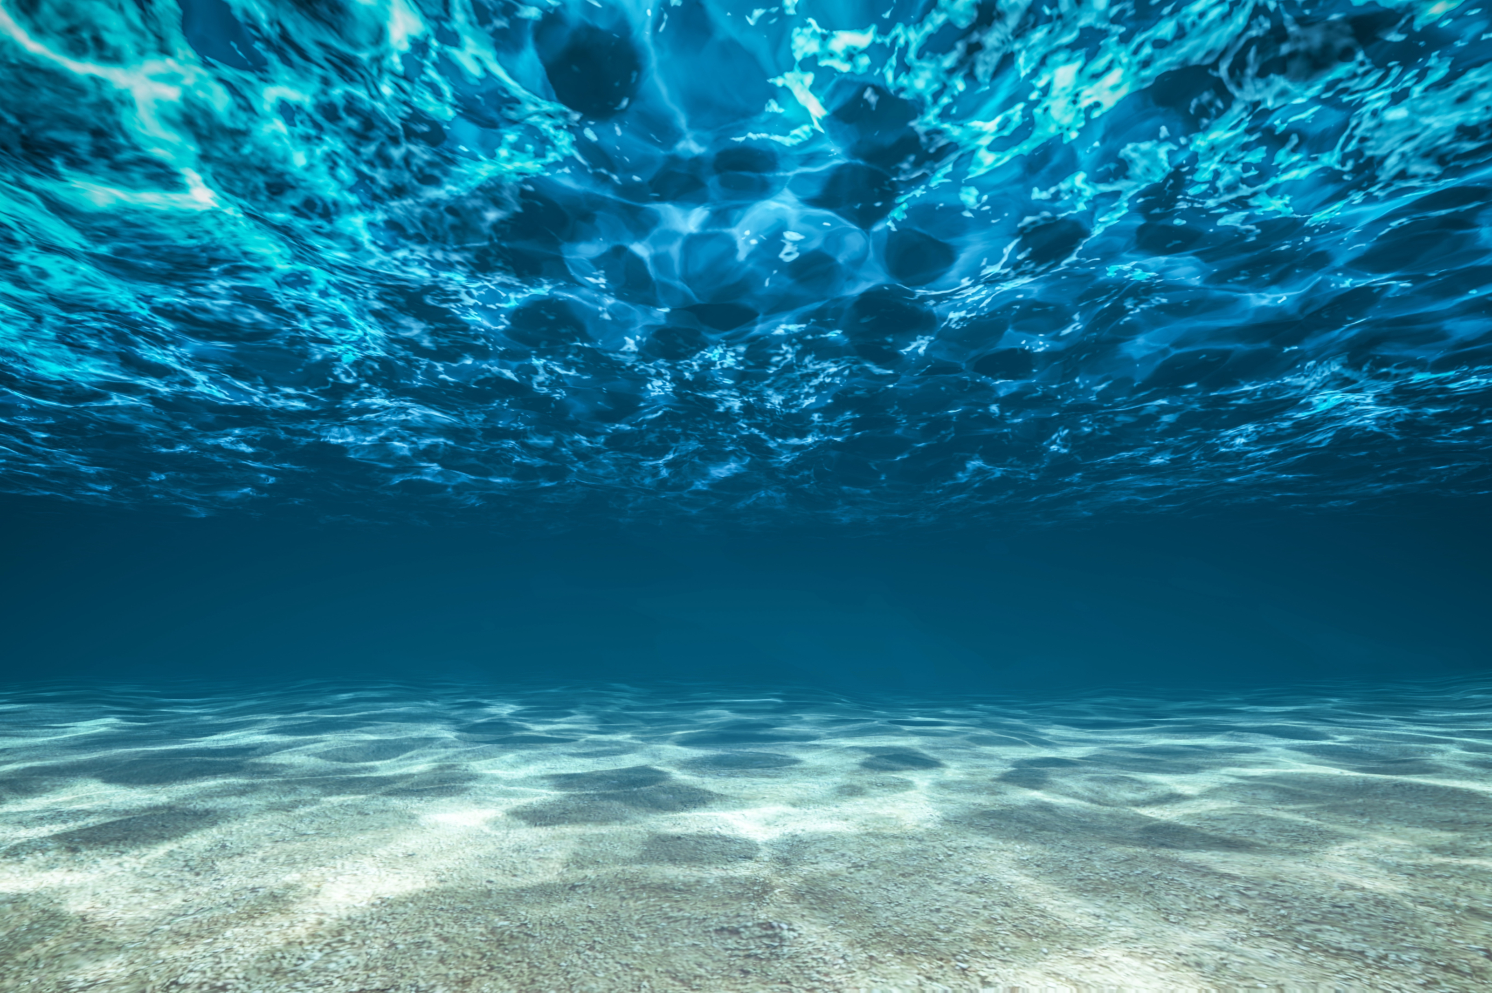
Testbed for underwater communication
Felipe Bahamondes, Mathias Markvardsen, Morten Henriksen

Slide 2

Guess a message!
Answer: ”Hello_there”

Slide 3
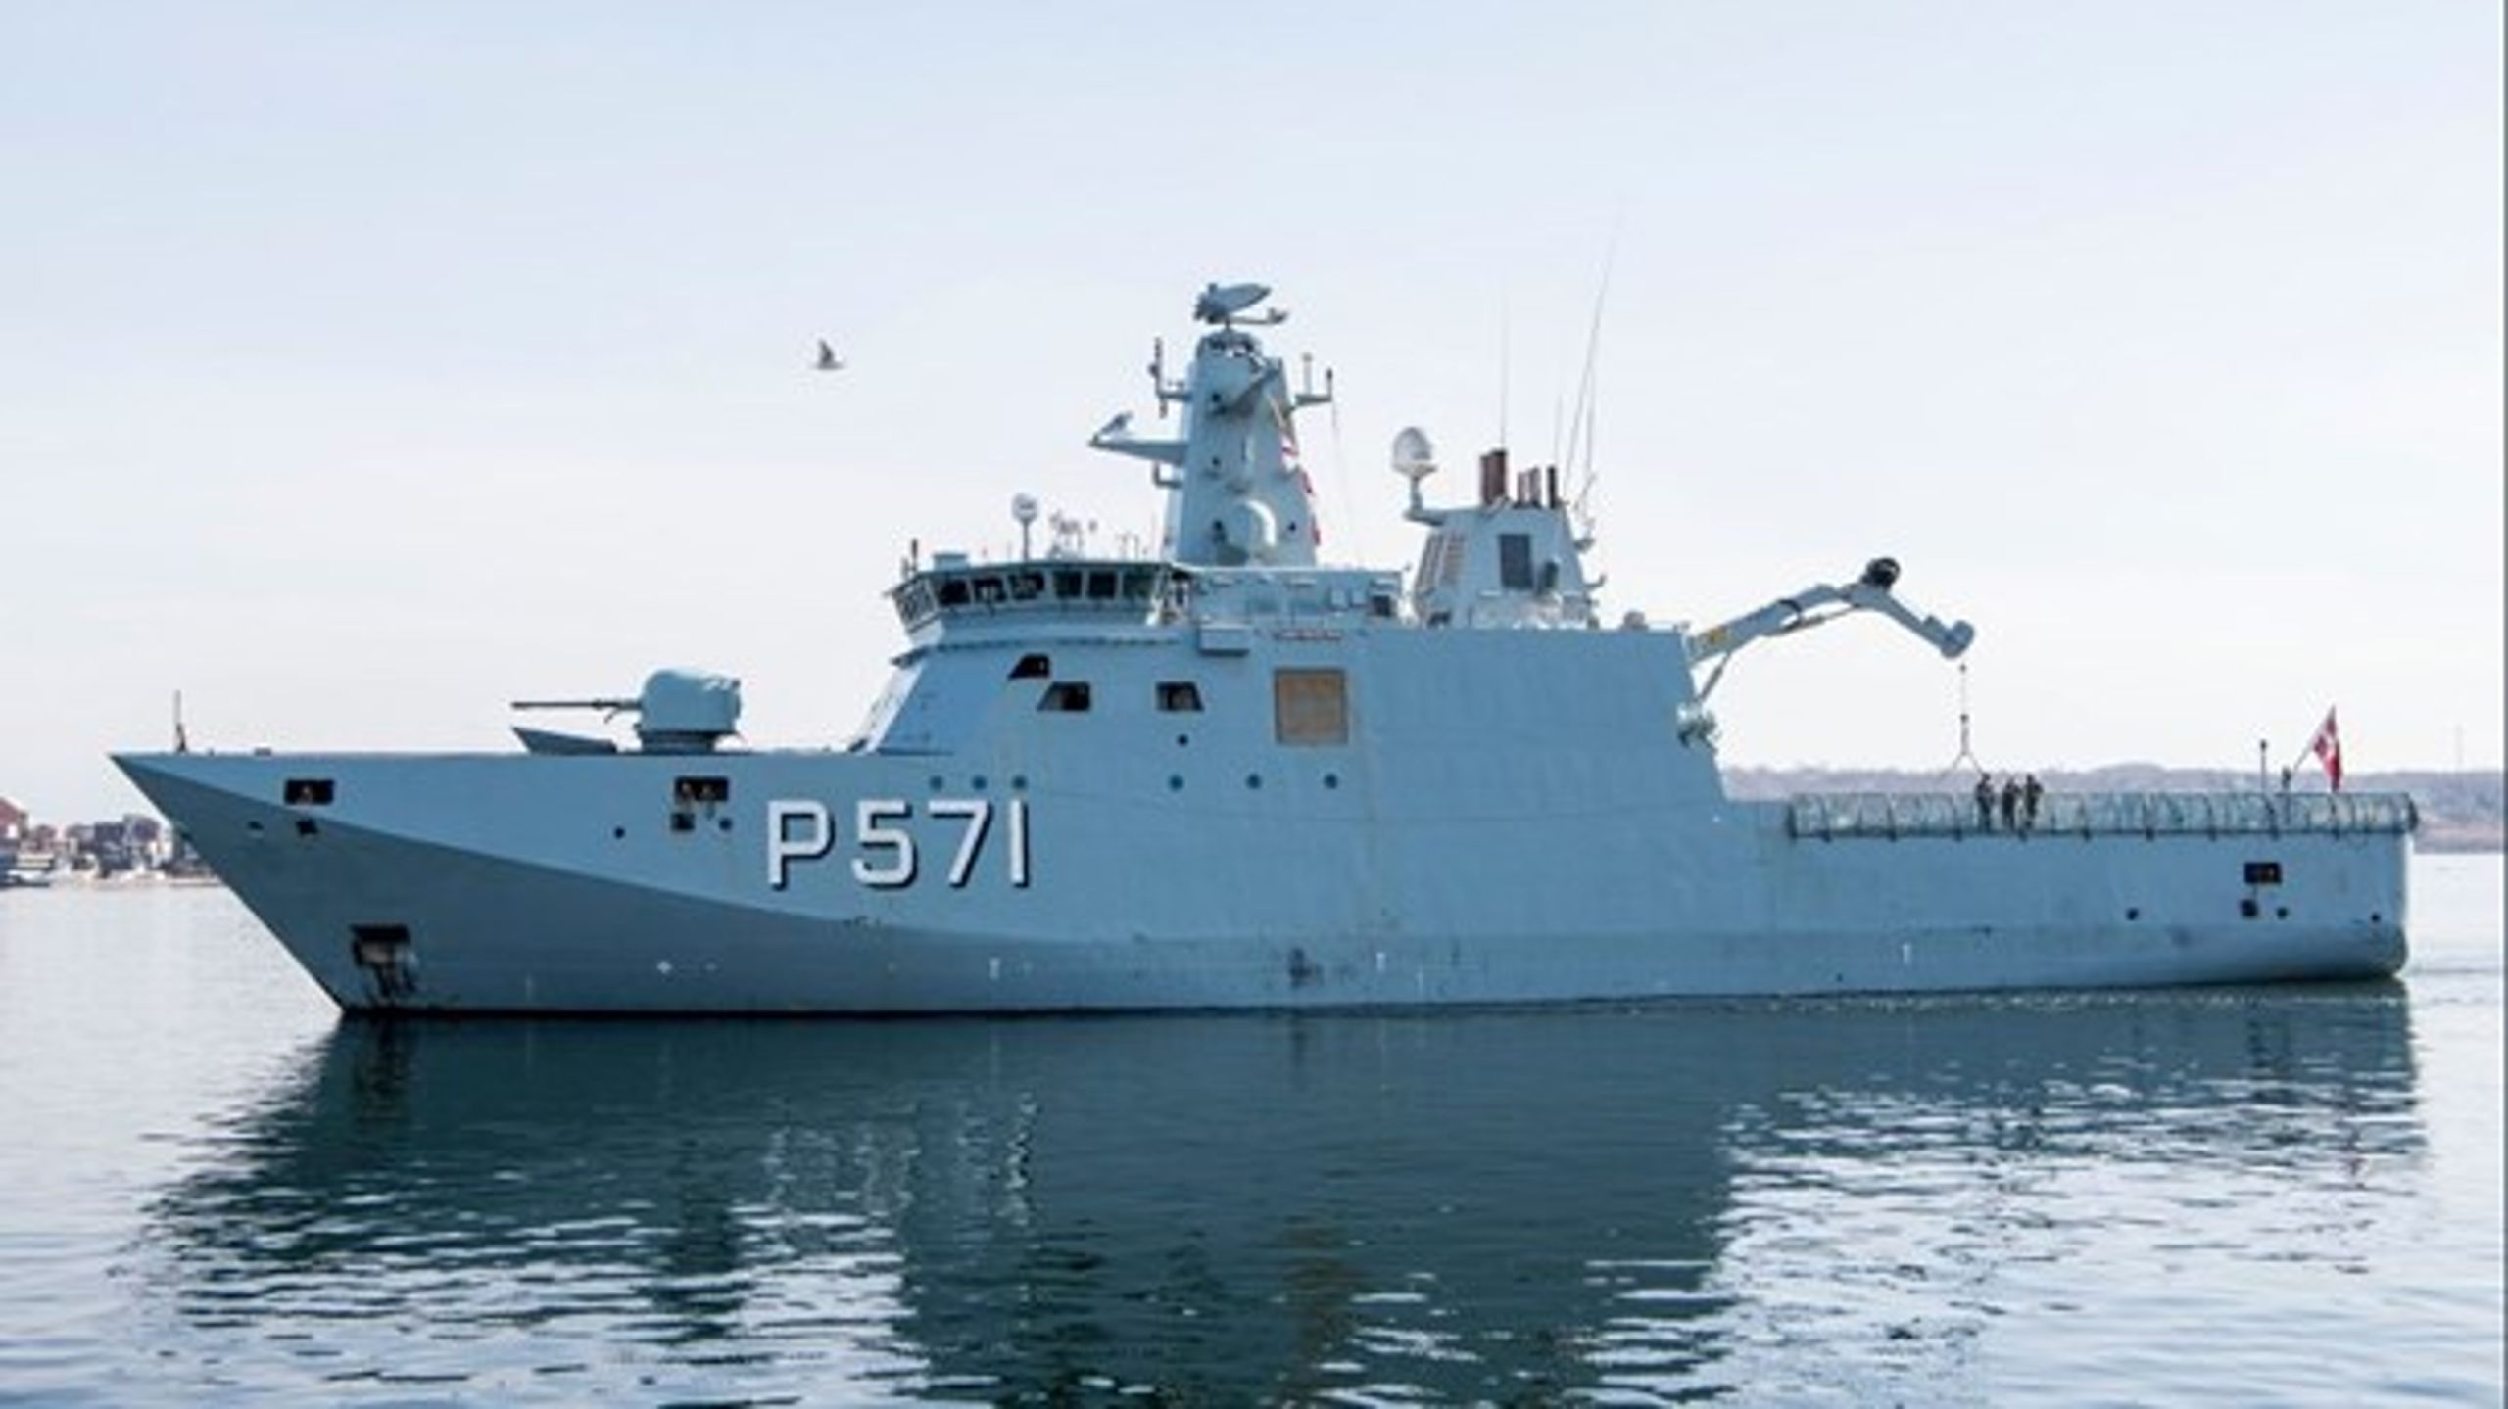
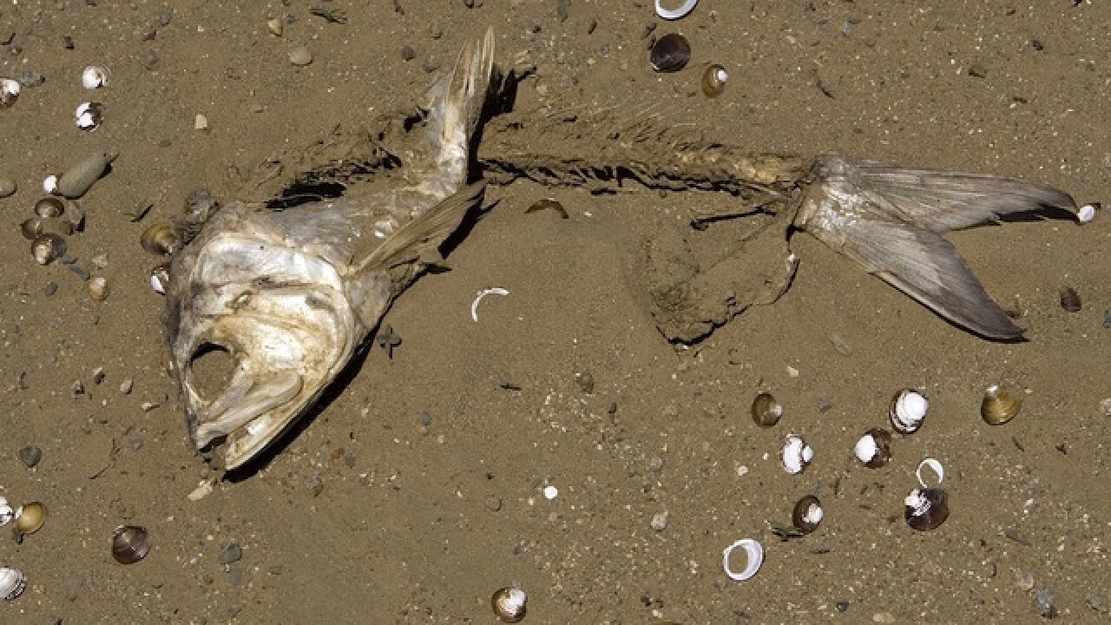
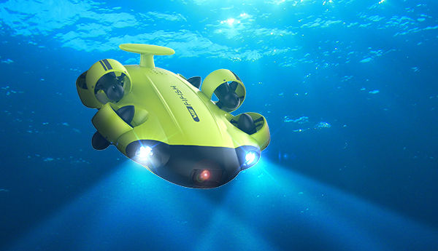
Project Details
Bachelor project
“The aim of this project is to design and implement a basic underwater communication system that can transmit data from an underwater speaker to a hydrophone receiver…”
A lot of freedom to choose
No prior knowledge
3 software students, who liked math and programming

Slide 4
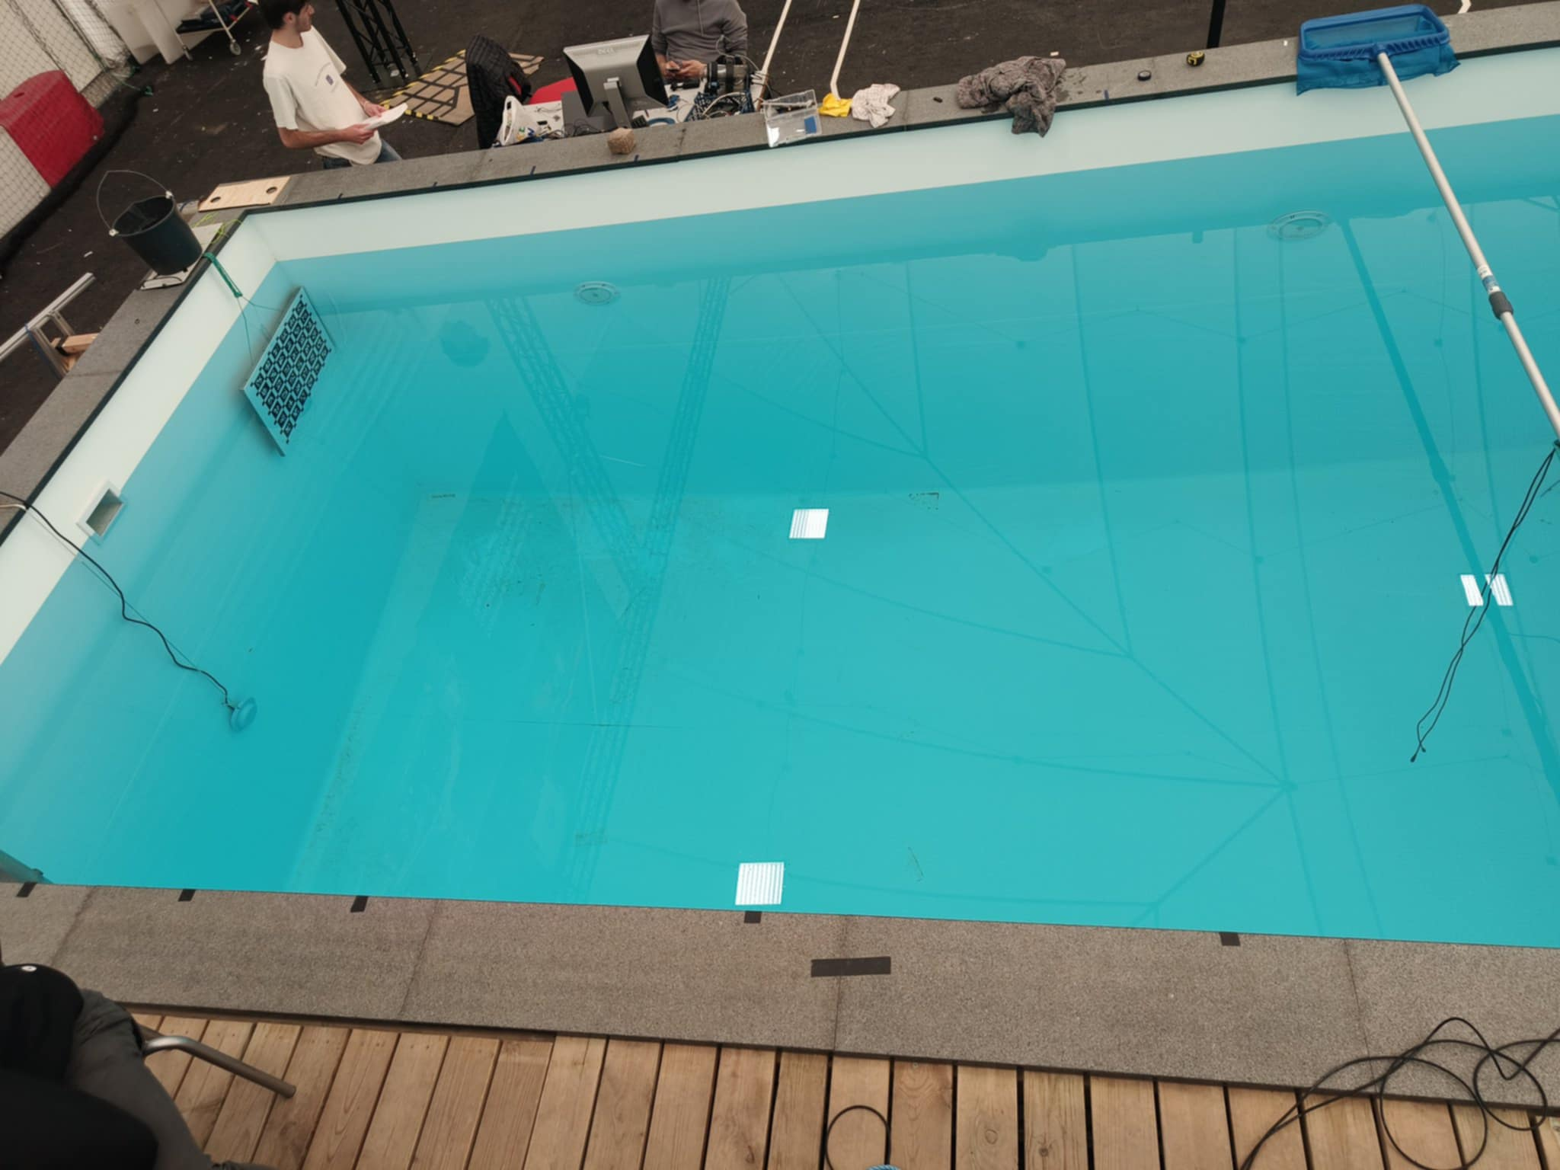
The Pool
Speaker
Hydrophone
2 m
5 meters

Slide 5
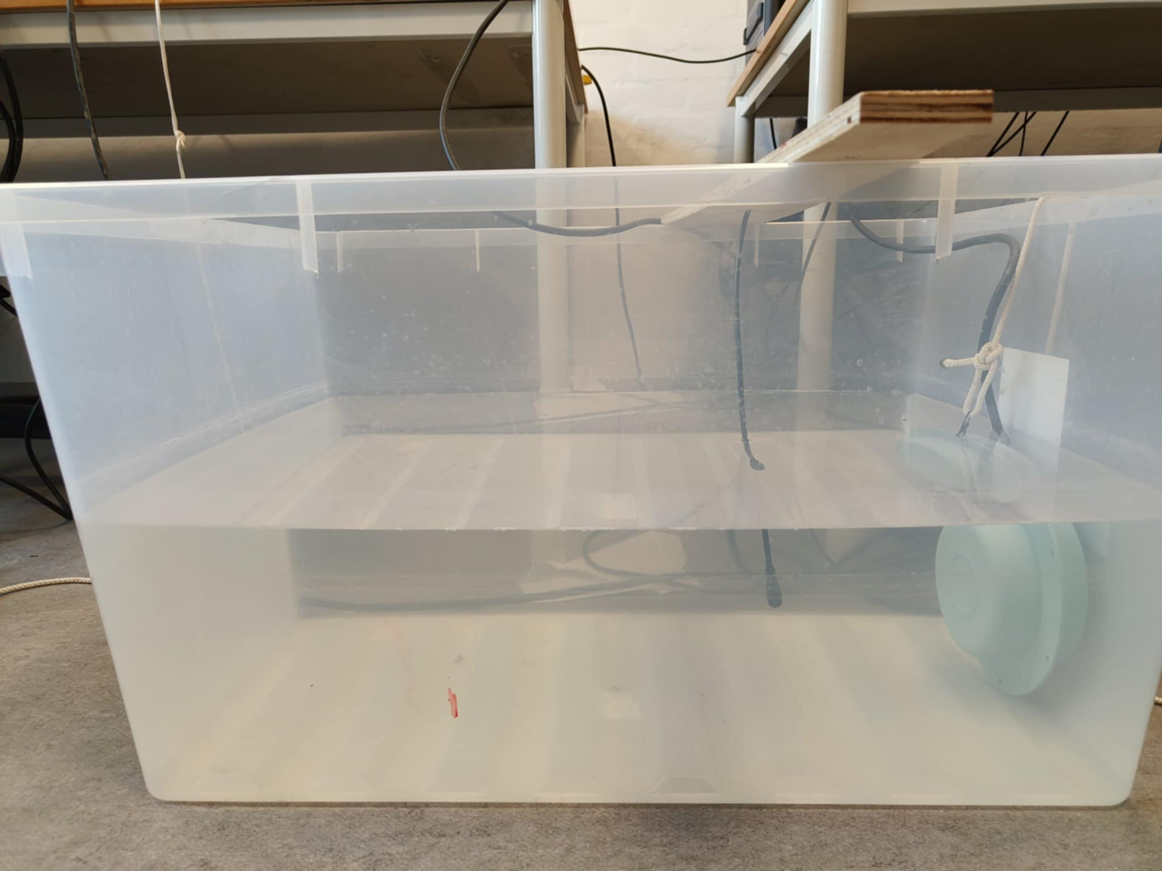
The Plastic Tank
Speaker
Hydrophone

Slide 6
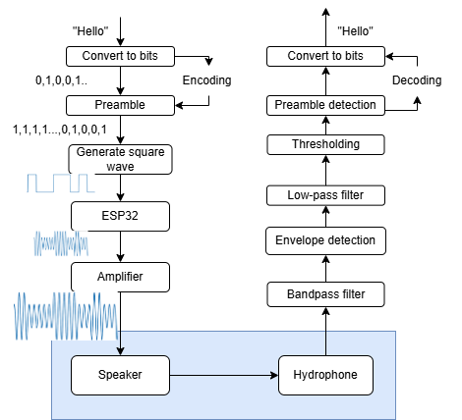
Protocol

Slide 7
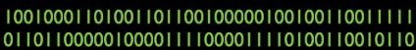
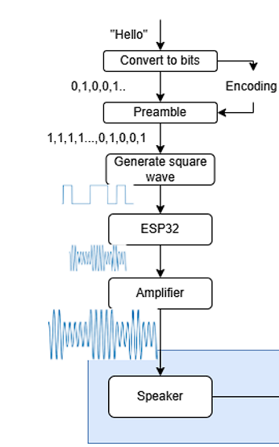
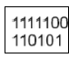
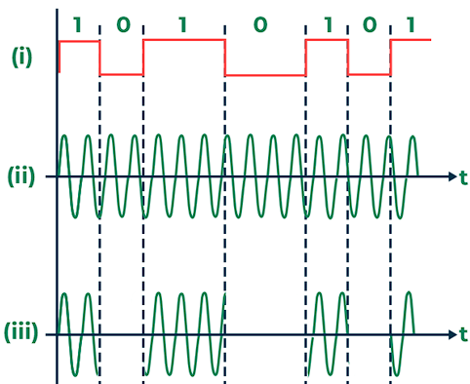
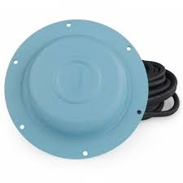
Transmitter

Slide 8
Reciever side
WAV.file (show pure recording) ->
bandpass filter (show what it does)->
Envelope detection ->
Normalize ->
Threshholding (converting signal to bit) ->
Preamble detection ->
Message

Slide 9
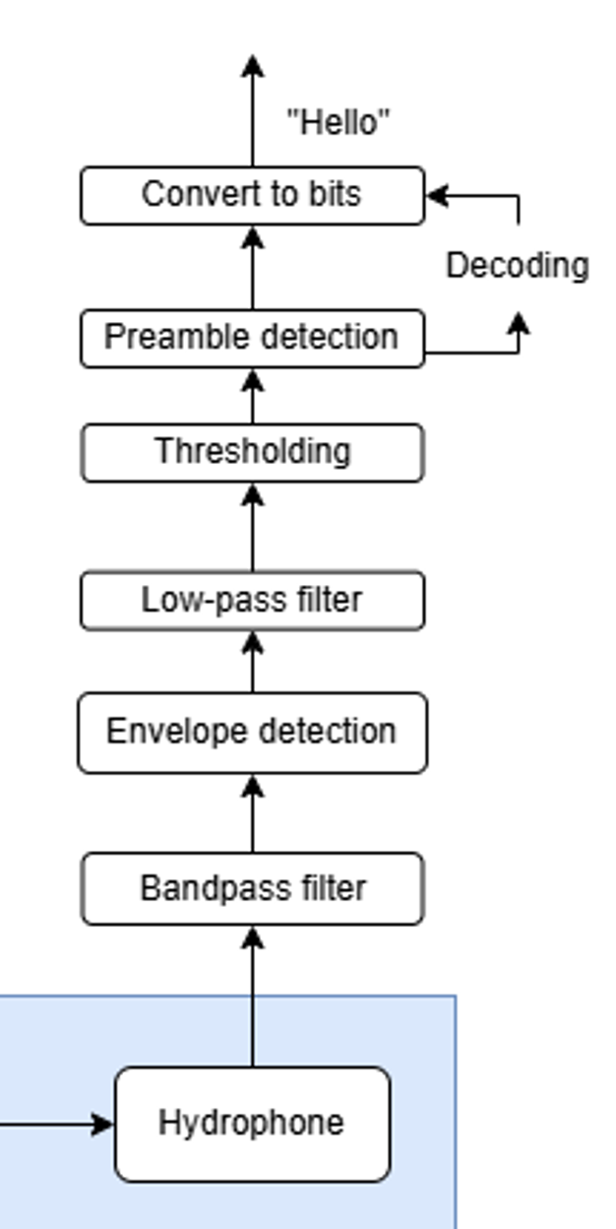

Receiver
The hydrophone is constantly monitoring pressure differences in the water (acoustic signals)
→ Converts to electricity
→ Computer RECORDS a wav file
Digital Signal Processing is fun!

Slide 10
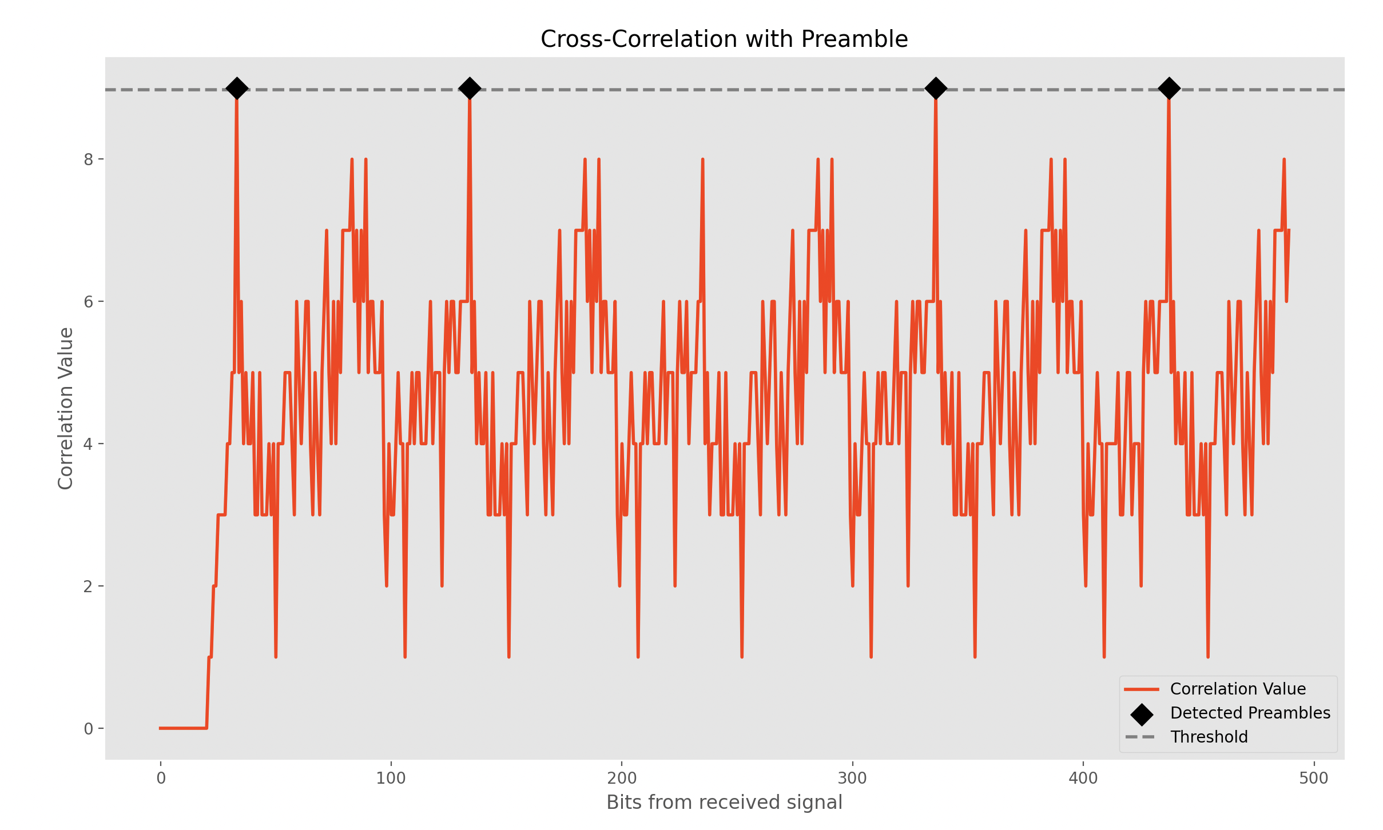
“Hello_there”
Bit rate : 500
Carrier Frequency : 6000kHz

Slide 11
Results

Slide 12
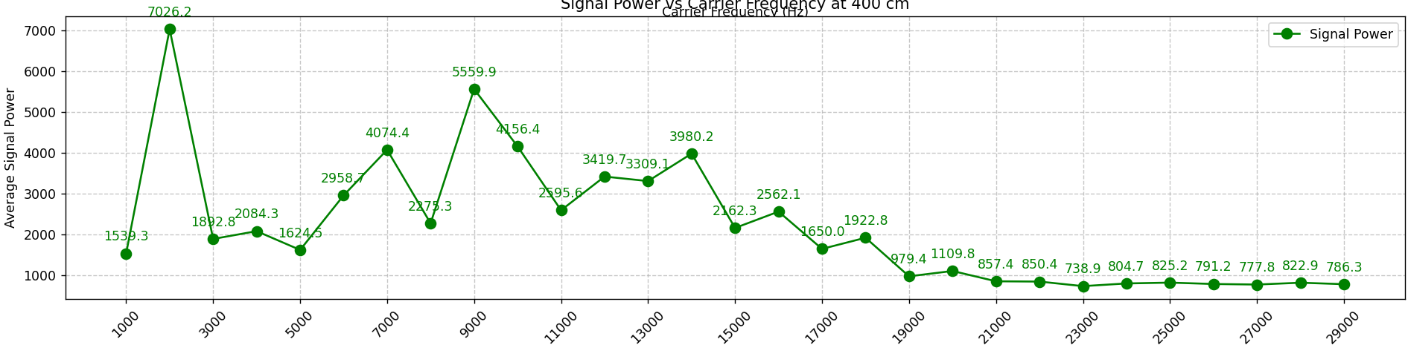
ATTENUATION
Average power vs. Carrier Frequency

Slide 13
INTERFERENS
ADD REVERSE PLOT OF THE PREVIOUS

Slide 14
And many others:

Slide 15
ADD LINE OVER HOW WELL THE SYSTEM RECEIVES COMPARED TO OTHER KNOWN STUFF

Slide 16
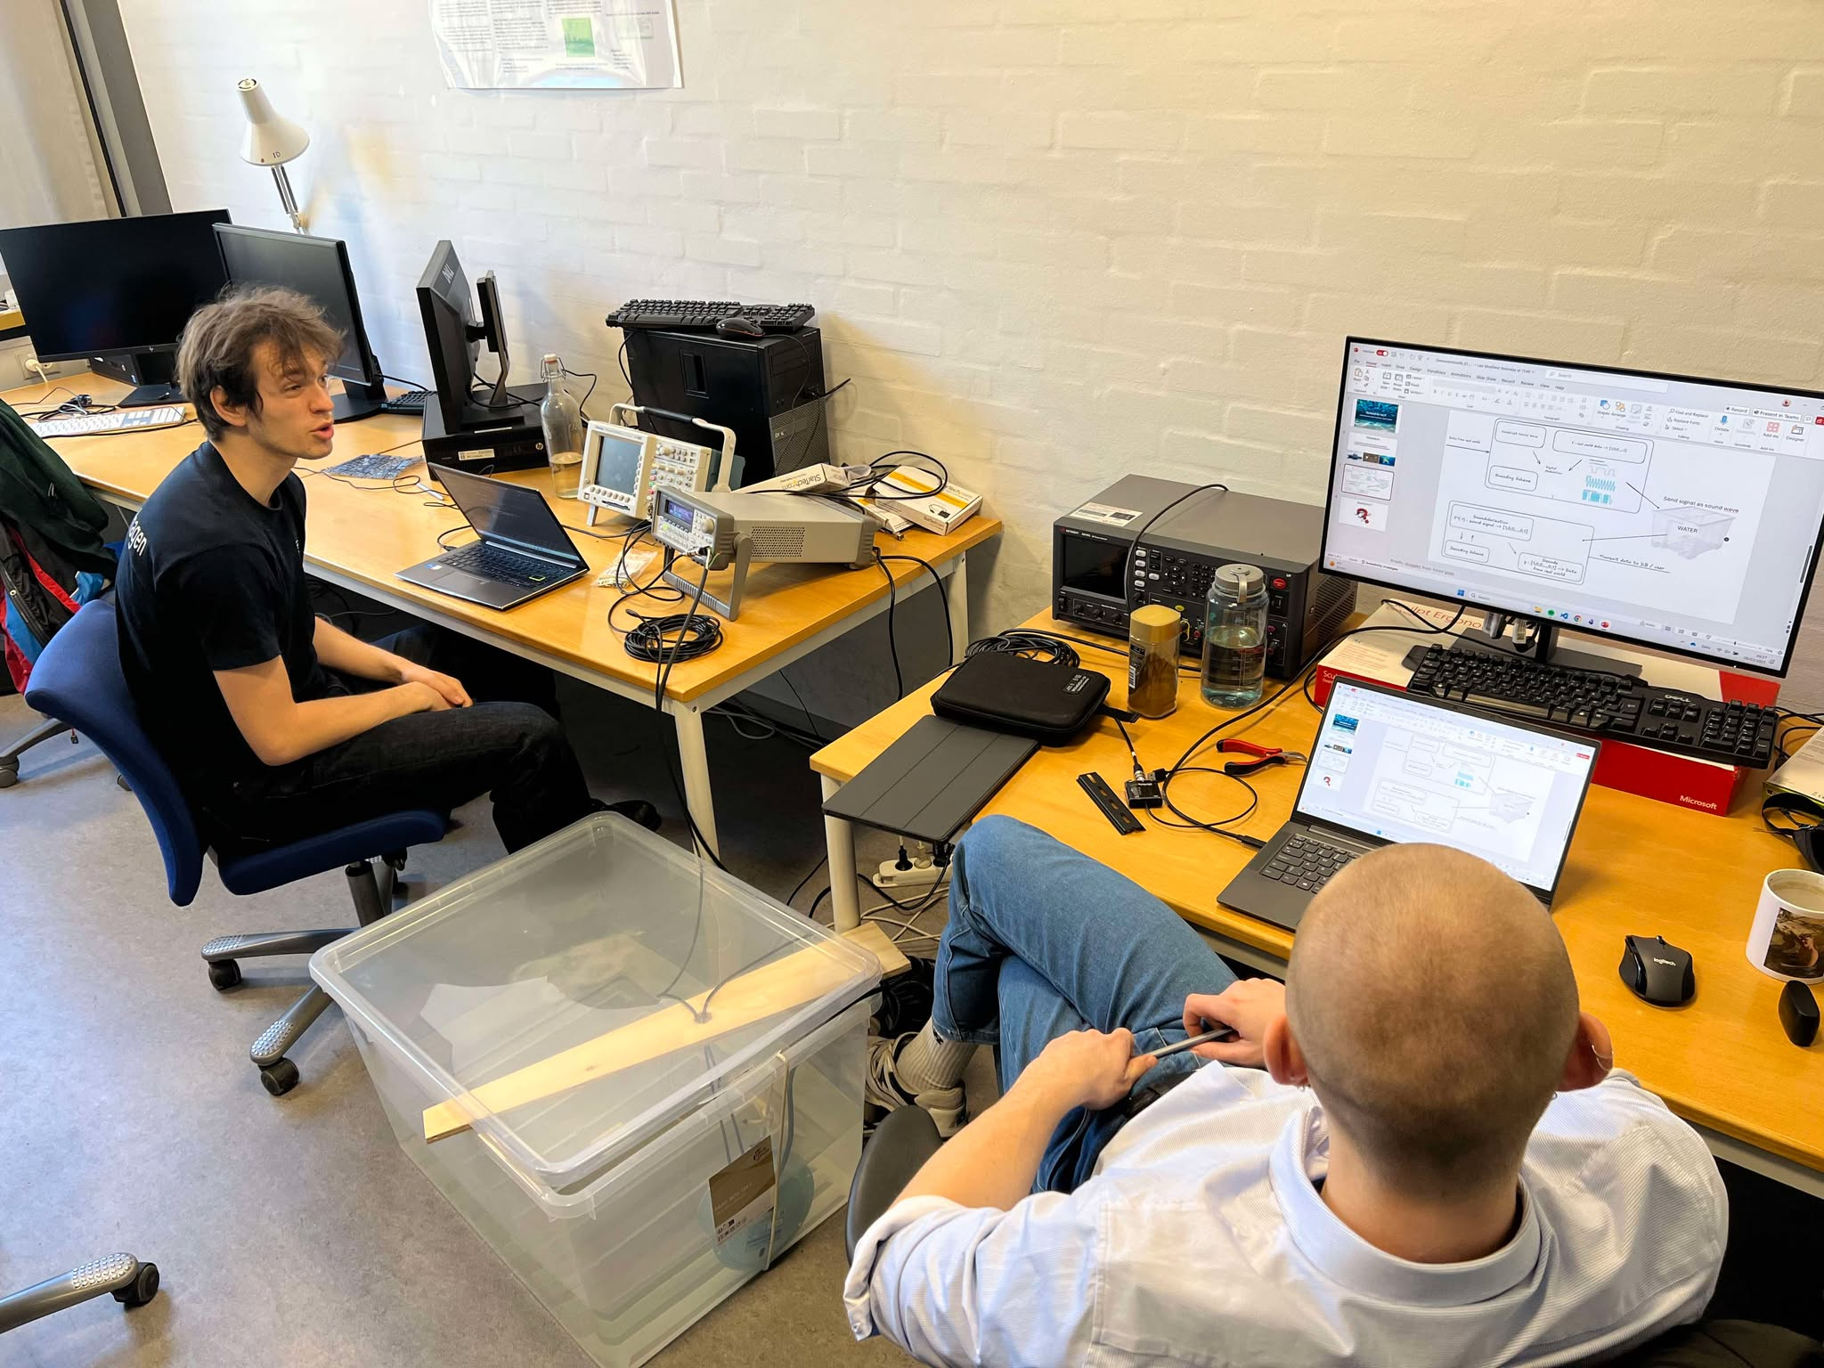
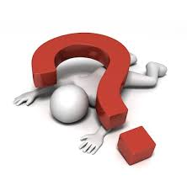
Questions?

